Slide 1
An Introduction to AI
“aimed at getting you to kickass in AI”
WEEK 1, COHORT 4

Slide 2
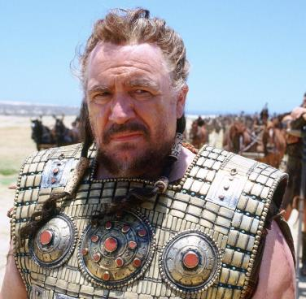


What is Artificial Intelligence?
Before we answer this question, let see if we remember some familiar personalities.
Agamemnon
Odysseus
Achilles

Slide 3
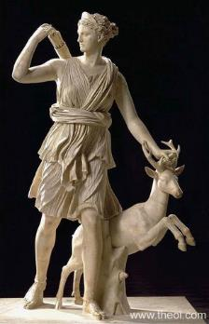
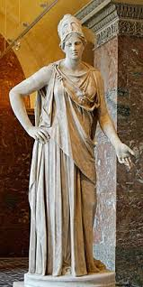
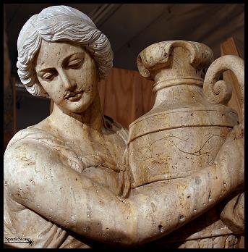
What is Artificial Intelligence?
How about these guys?
Artemis
Athena
Thetis
What do they all have in common?

Slide 4
What is Artificial Intelligence?
How about these guys?
Artemis
Athena
Thetis
What do they all have in common?
Prophesy, and we can say Prophesy which is Prediction, is the act of saying what will happen in future

Slide 5
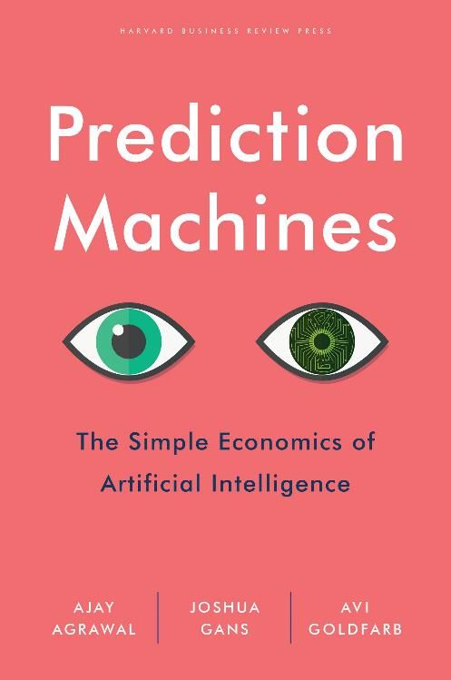
What is Artificial Intelligence?
Back to Artificial Intelligence
“The current wave of advances in AI doesn’t actually bring us intelligence but instead a critical component of intelligence, prediction”
AI, in the broadest sense, describes the different ways a machine interacts with the world around it. To maximize our chance of achieving a given goal. At it core, ML is a simply way of achieving AI.

Slide 6
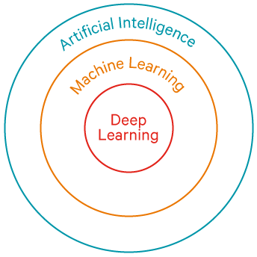

Overview of Artificial Intelligence

Slide 7
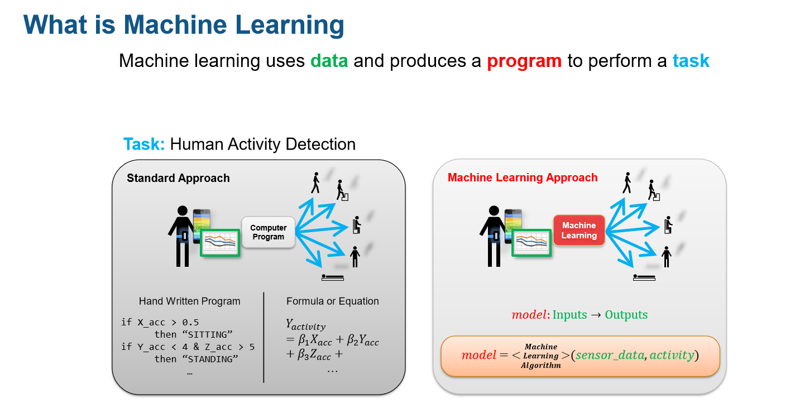
Machine Learning
What is Machine Learning

Slide 8
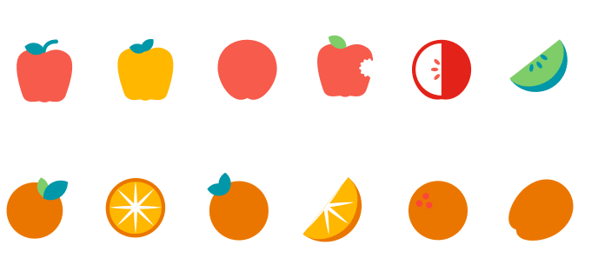
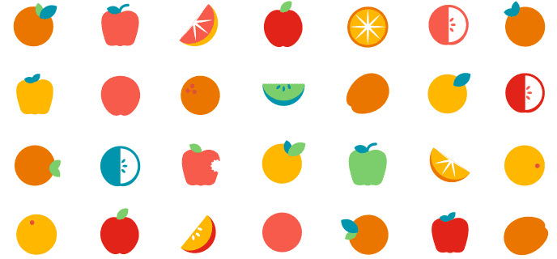
Machine Learning vs Deep Learning
ML
DL
ML - subset of AI
Machines learn to do task without explicitly programmed to do so.
Reinforcement learning, decision tree, DL, clustering …
DL - subset of ML
DL learns to do task without explicitly programmed to do so.
Mimics the neurons in a human brain.
CNN, RNN, AutoEncoder …

Slide 9
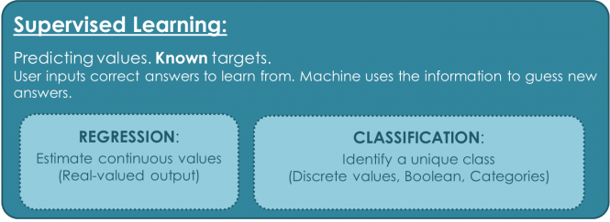
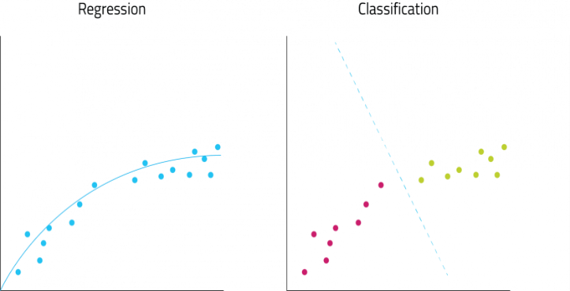
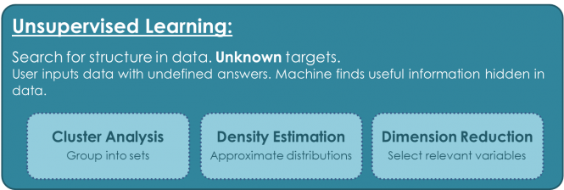
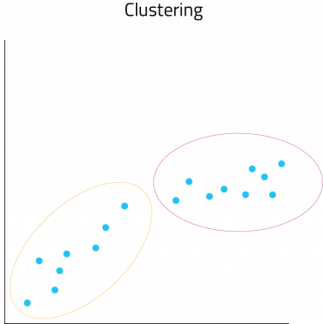
Classes of Machine Learning
Others: RL

Slide 10
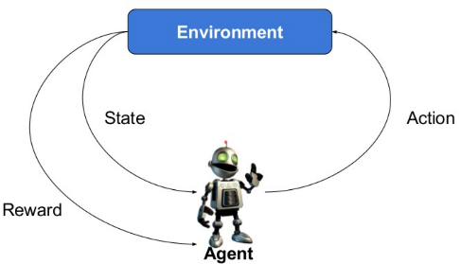
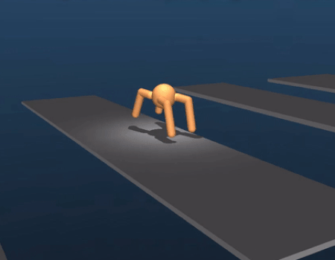
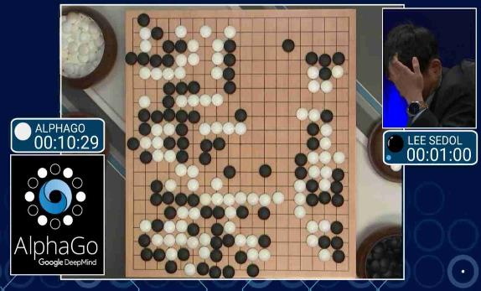
Reinforcement Learning
In the problem, an agent is supposed decide the best action to select based on his current state which will earn the agent a reward. When this step is repeated, the problem is known as a Markov Decision Process.
Deep Minds
Alpha Go

Slide 11
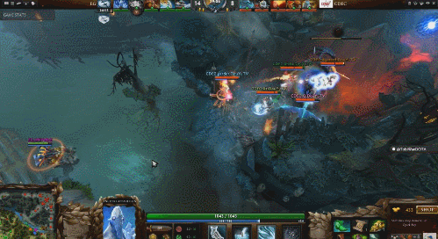
Reinforcement Learning
Dota 2
Using a separate LSTM for each hero and no human data, it learns recognizable strategies.
OpenAI Five plays 180 years worth of games against itself every day, learning via self-play.
Open AI Bots vs Humans

Slide 12

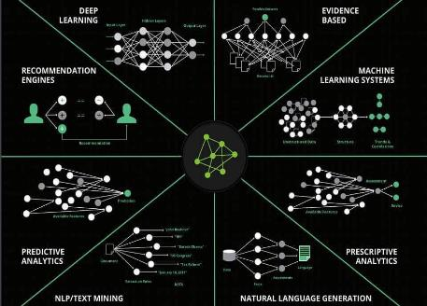
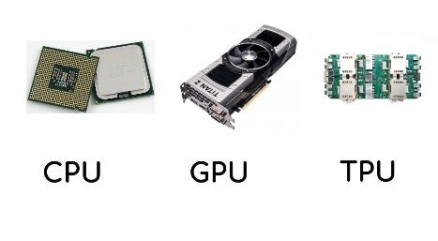
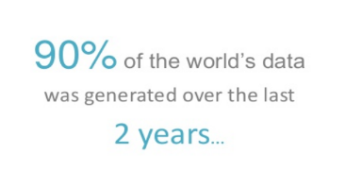
Deep Learning
Lets focus a little more on Deep Learning.
Why deep learning is having great impact in the world?
Computational Powerhouse
Massive Data
Modern Algorithms

Slide 13
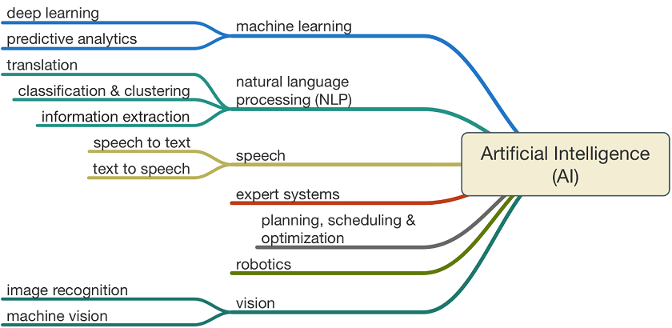
Deep Learning
DL isn't a single approach but a rather a class of algorithms that you can apply to broad spectrum of problem.

Slide 14
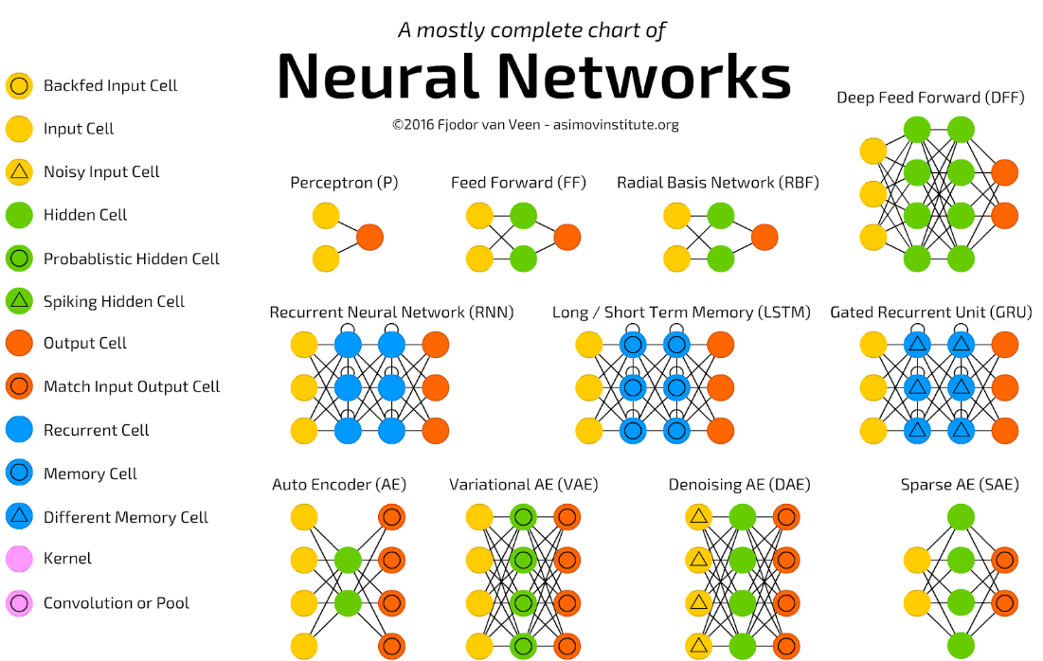
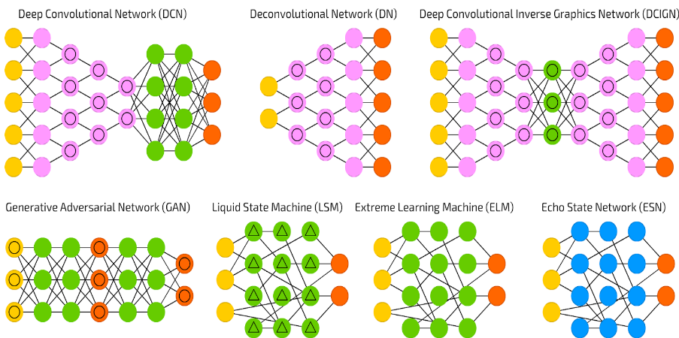
Deep Learning
There are different types of Deep Learning Architecture

Slide 15
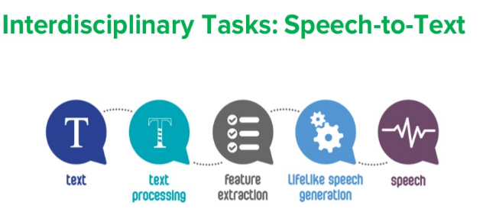
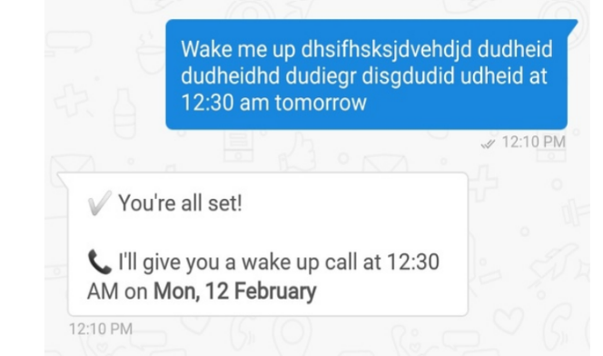
Deep Learning
Natural Language Processing
Study of interaction between computers and human languages.
Why NLP is hard?
Sentimental analysis
Chatbot
Machine translation
Text classification
300+ ethnic groups in Nigeria( NLP Bigger than Wazobia)
Languages are ambiguous(“I love Blackberry?”)
Interpretation of context(I am hungry, because I am broke)
Machine don’t understand Language.

Slide 16
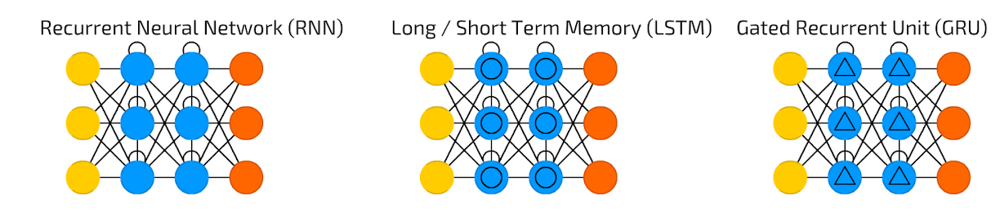
Deep Learning
Natural Language Processing – Architectures
Feed-forward network
Feedback mechanism
Memory cell
Retain information
Can remember info. Not just the last computed value.
Faster and simpler LSTM
Fewer weight
Two gates
Update gates - maintain info.
Reset gates - flush info.

Slide 17
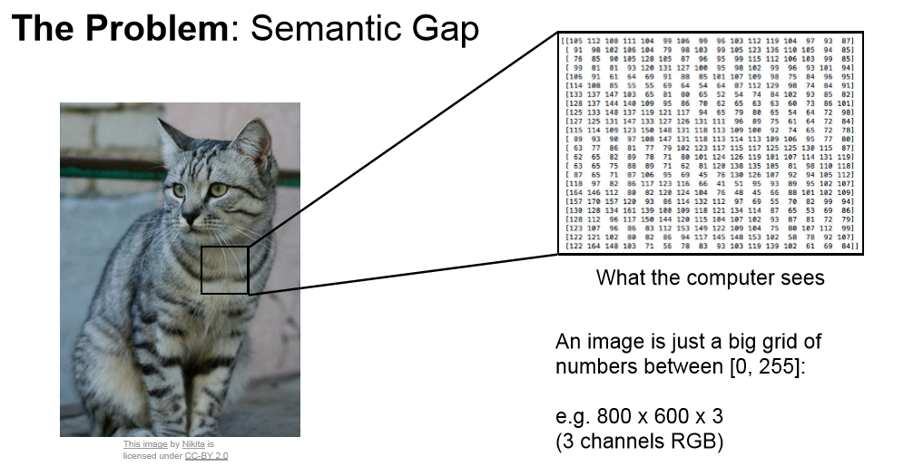
Deep Learning
Computer Vision
Is a field of computer science that works on enabling computer see, identify and process images. CV is linked with AI as computer must interpret what it sees and perform necessary analysis.

Slide 18
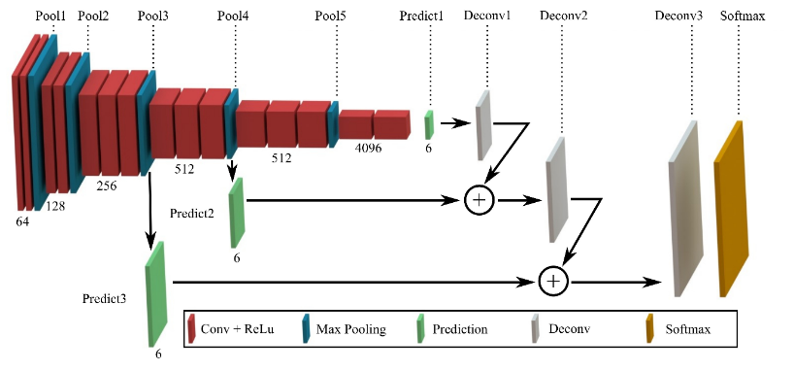
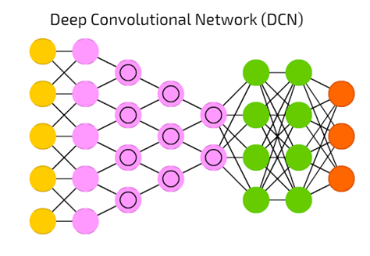

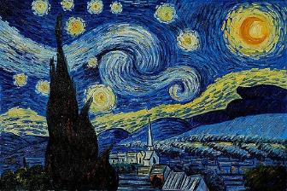
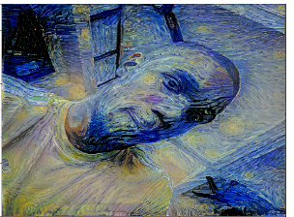
Deep Learning
Computer Vision– Architectures
Inspired by the brain visual cortex
High Image processing application
Learn higher-order features in data via convolution.
Convolve the filter/kernel with the i.e “slide over the image spatially computing dot products”
+
=
Style Transfer

Slide 19






EVERYDAY APPLICATIONS OF AI

Slide 20
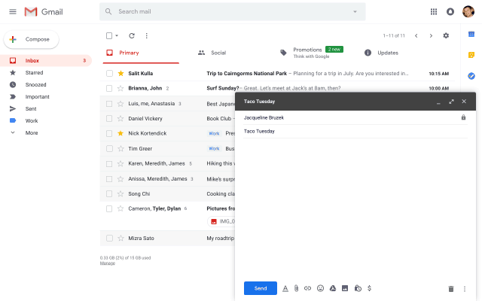
Gmail – Smart Compose
Typical language generation models, such as ngram, neural bag-of-words (BoW) and RNN language(RNN-LM) models, learn to predict the next word conditioned on the prefix word sequence.

Slide 21
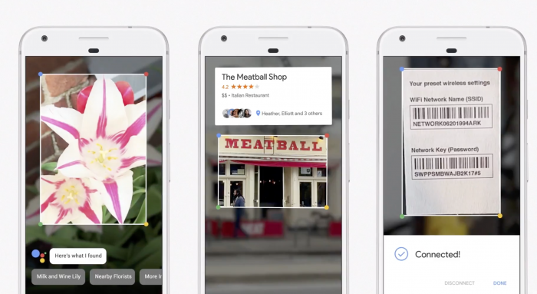
Google Len

Slide 22
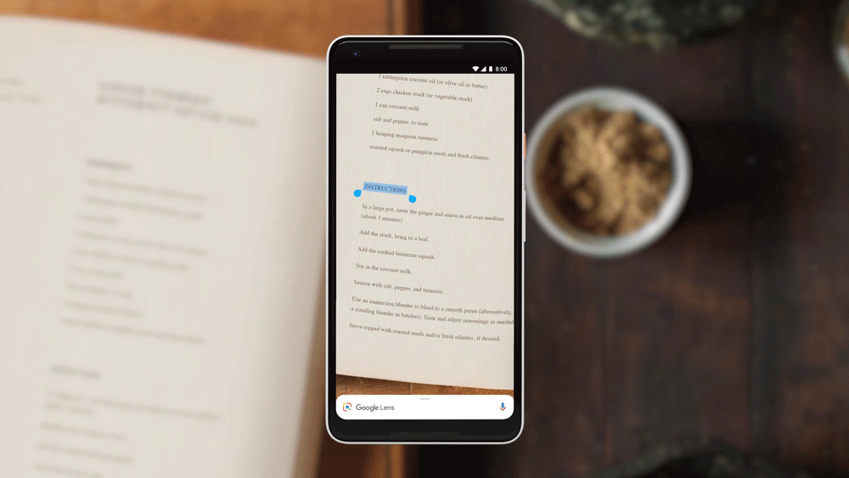
Google Len - Text Selection
Google leveraged on digitization of books around the world.

Slide 23
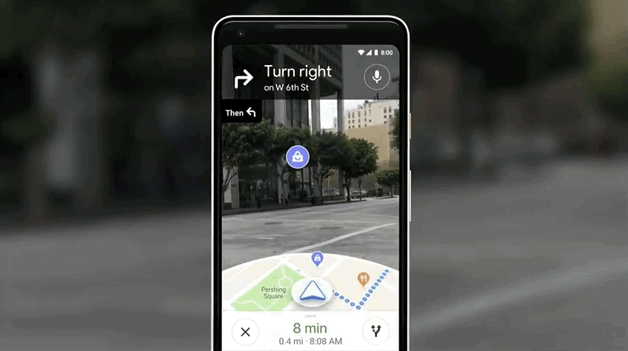
Google Map
Google leveraged on geo-location mapping.

Slide 24
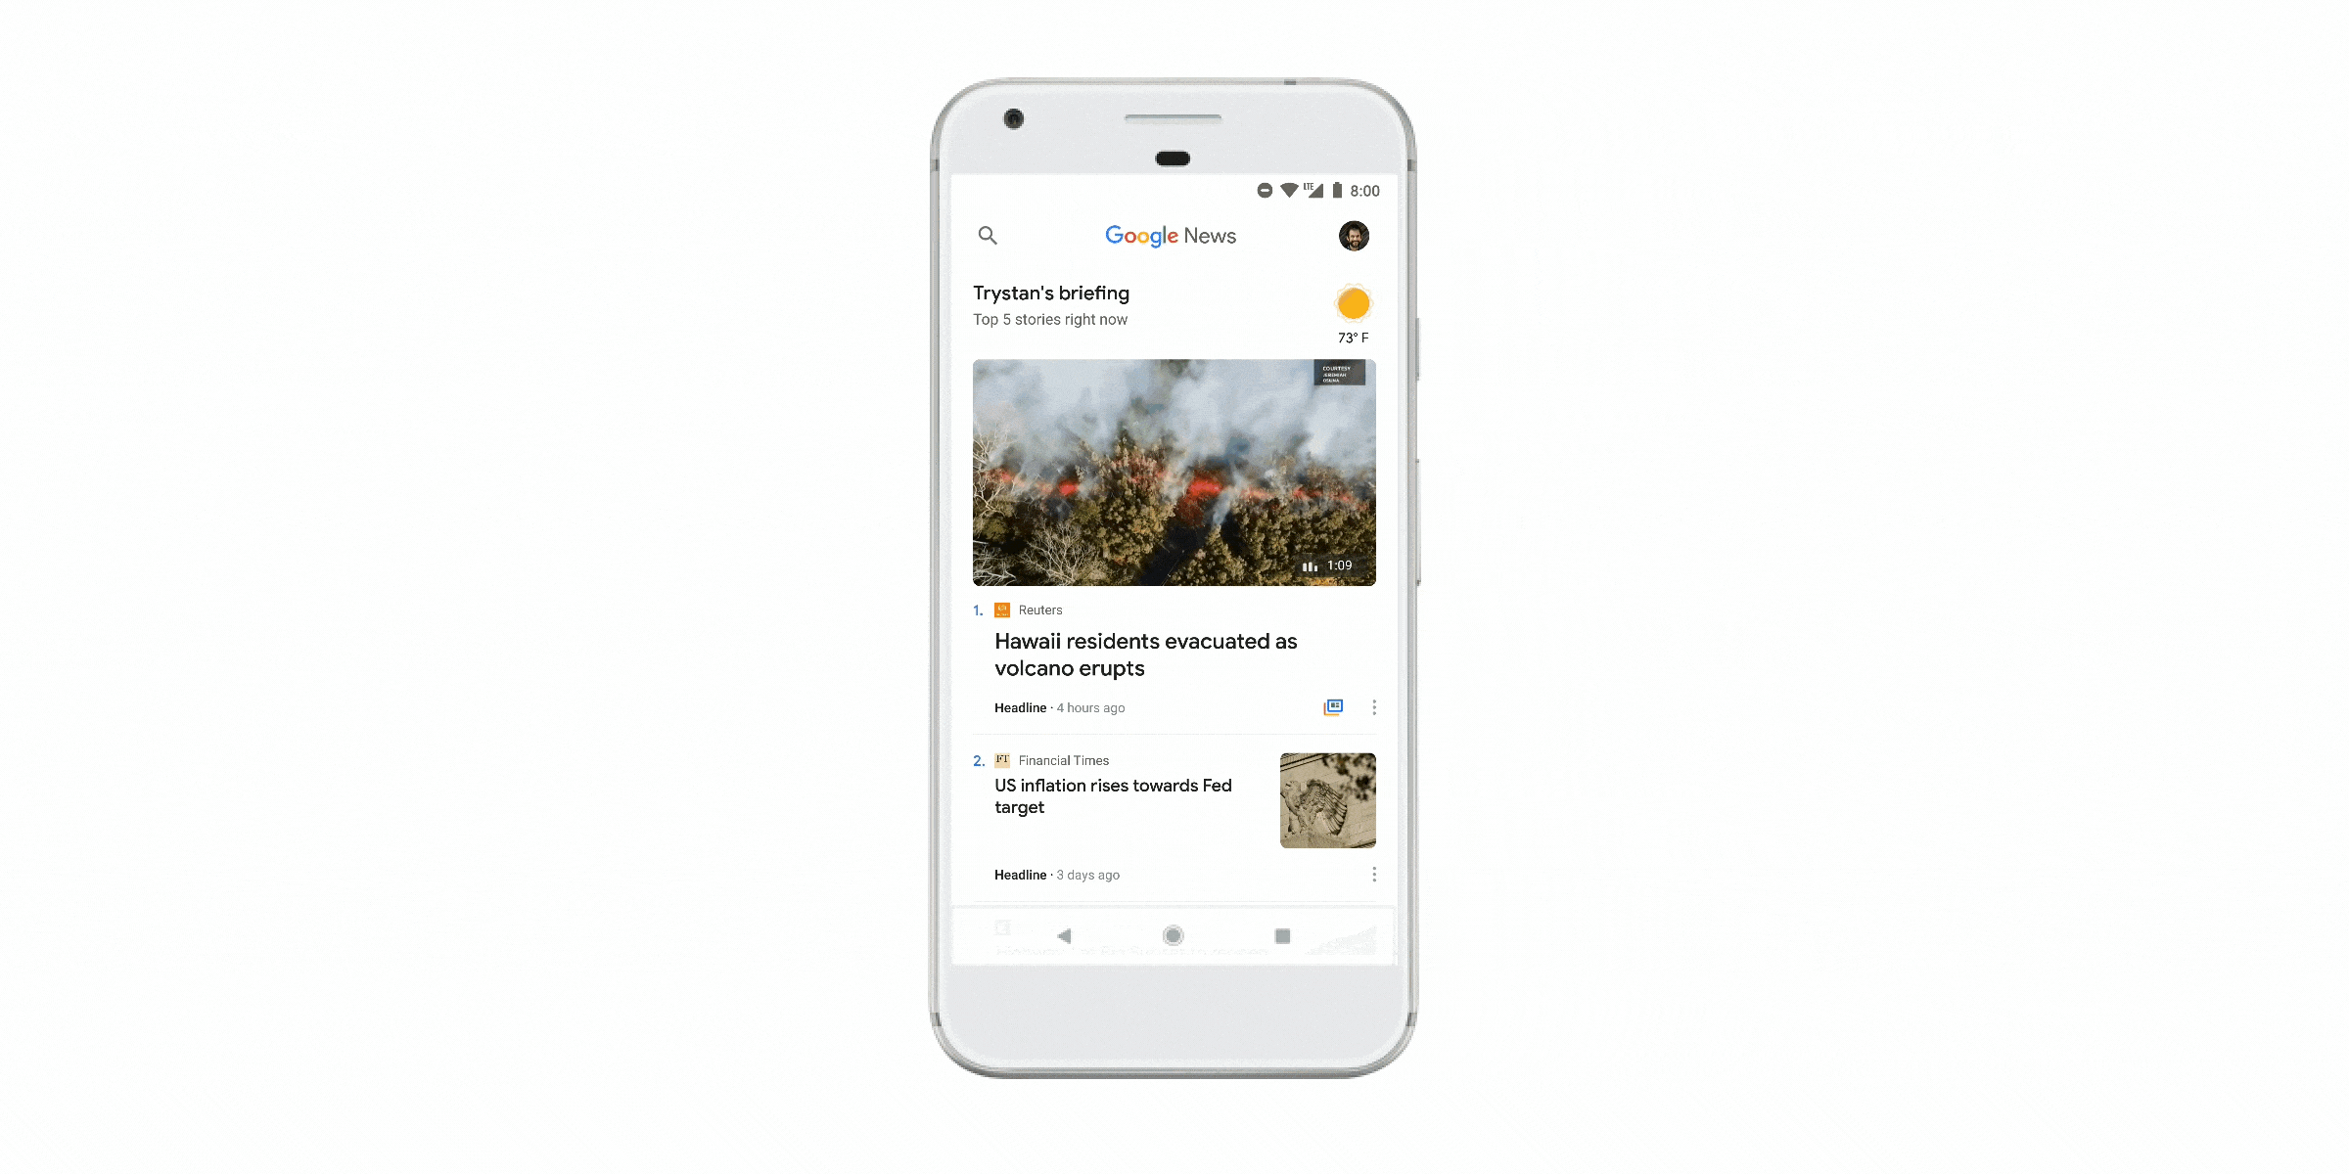
Google News
Clustering
Recommender System
Topic modelling

Slide 25
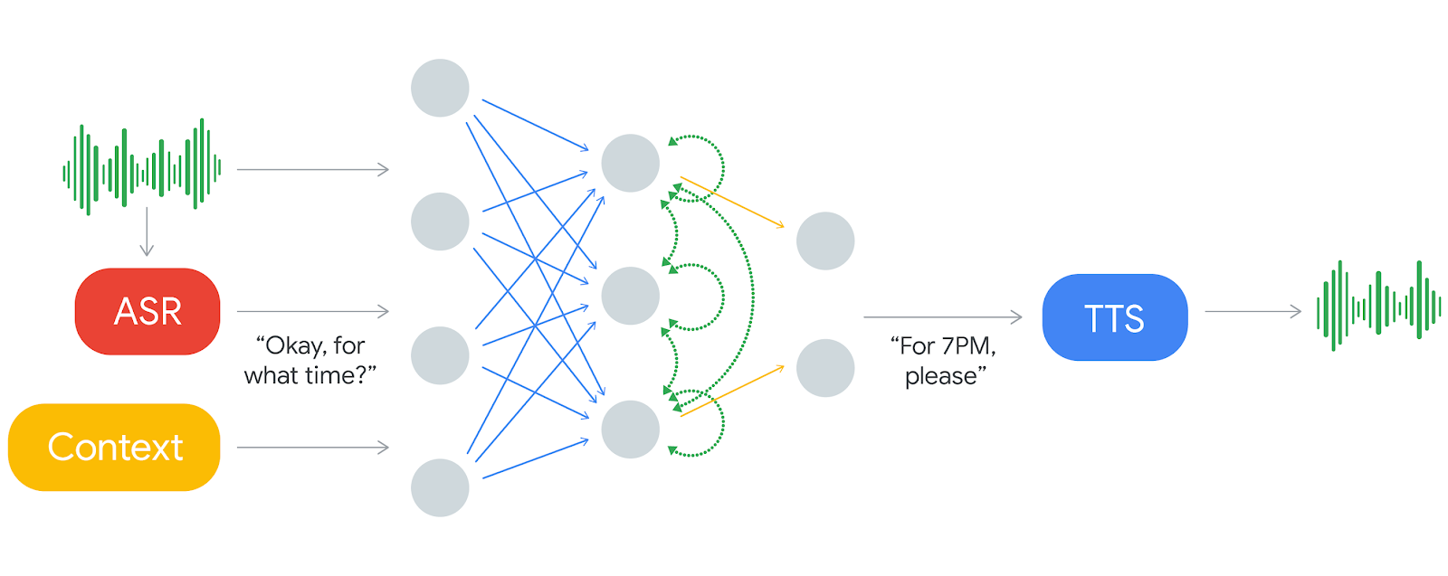
Google Assistant - WaveNet
The ability of computers to understand natural speech has been revolutionised in the last few years by the application of deep neural networks (e.g., Google Voice Search). However, generating speech with computers — a process usually referred to as speech synthesis or text-to-speech (TTS).

Slide 26
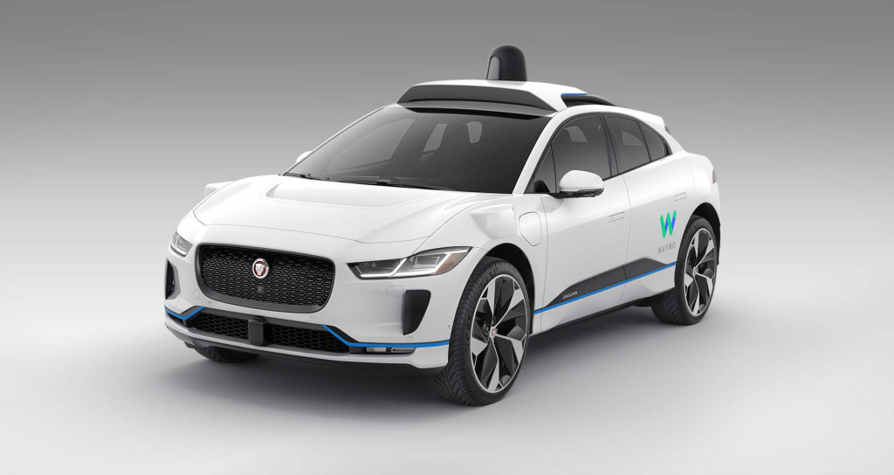

Waymo

Slide 27
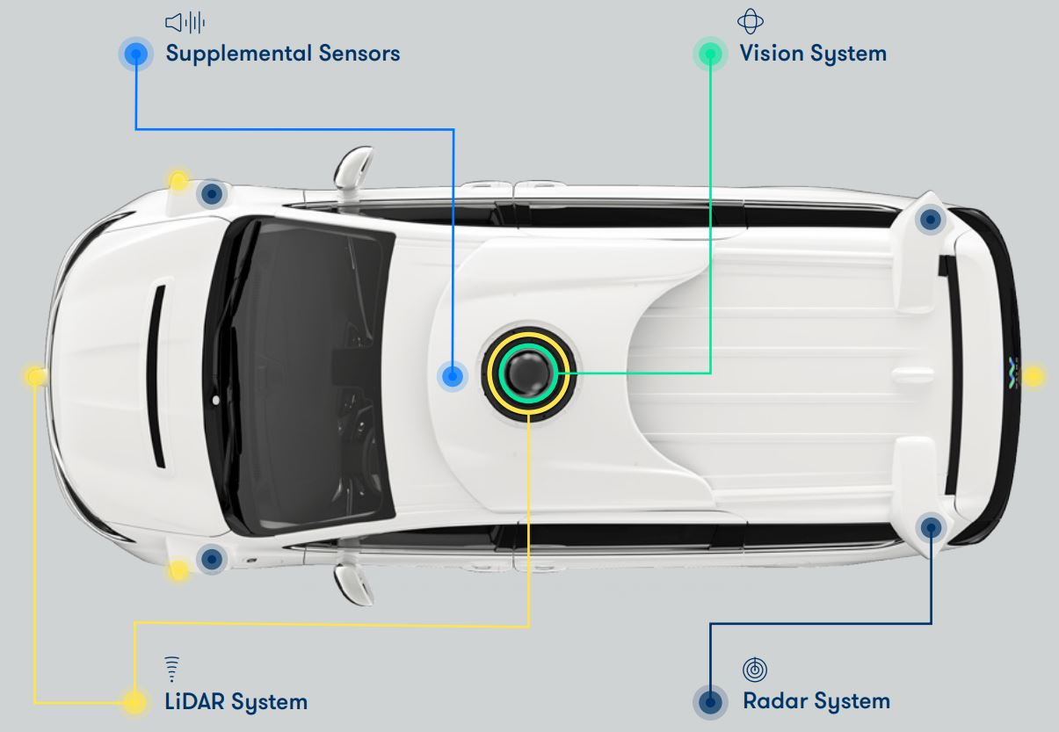
Waymo
Radar: a device that sends radio wave to find out the position and speed of moving object.
Lidar: like radar, but instead of sending out radio waves it emits pulses of infrared light—aka lasers invisible to the human eye.
Vision: High end camera for real-time object detection.
Sensor fusion and deep learning.

Slide 28
Generative Adversarial Networks
The Bleeding Edges of AI

Slide 29
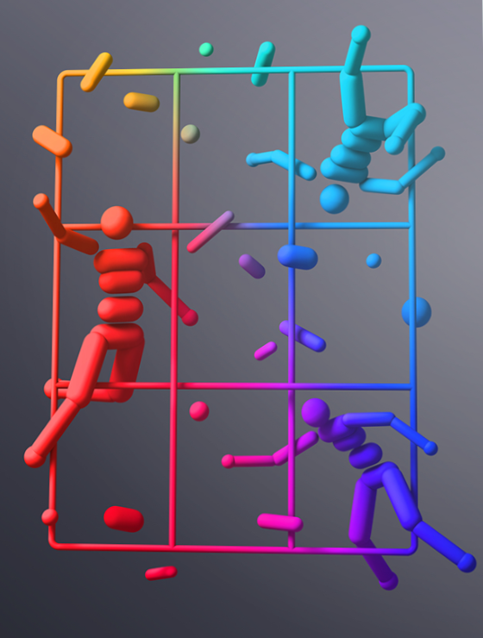
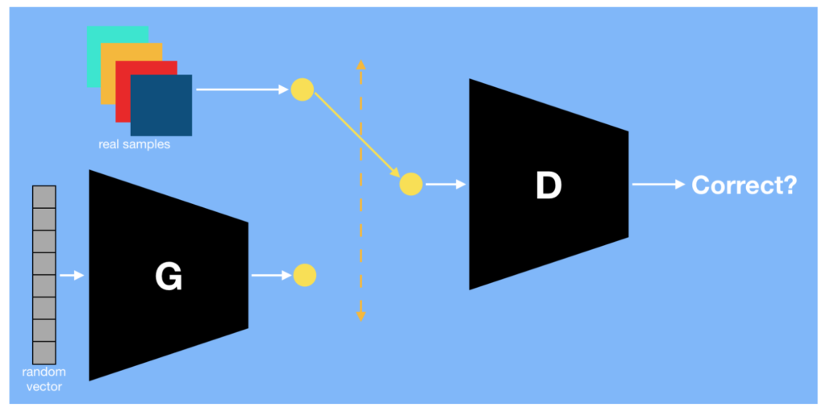
GANs
A generative Adversarial Network is a class of machine learning system invented by Ian Goodfellow and his colleagues in 2014.
Two neural networks contest with each other in a game.

Slide 30
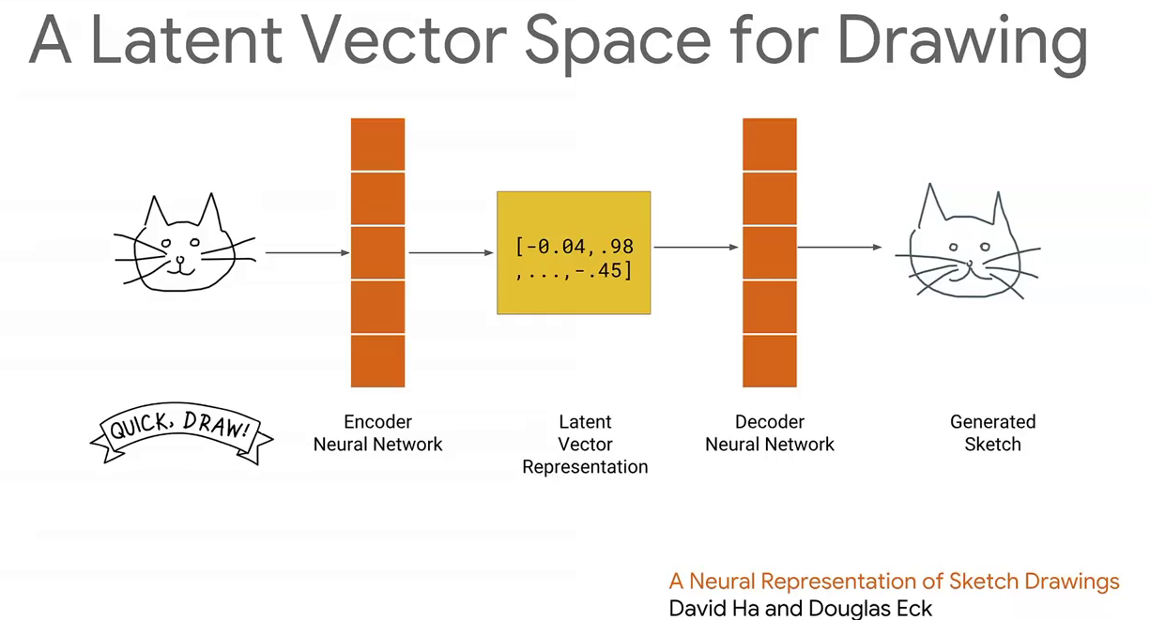
GANs - Application

Slide 31
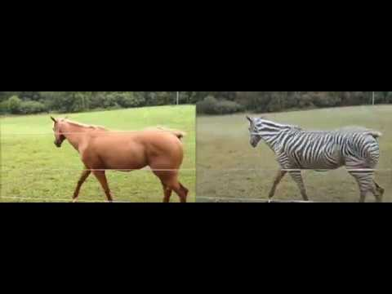
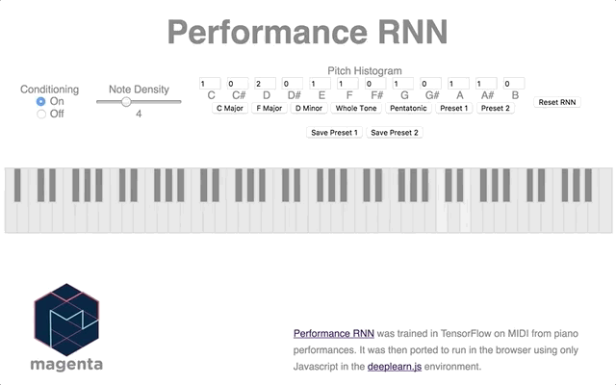
GANs - Application
Generation of music
Generation of Art

Slide 32
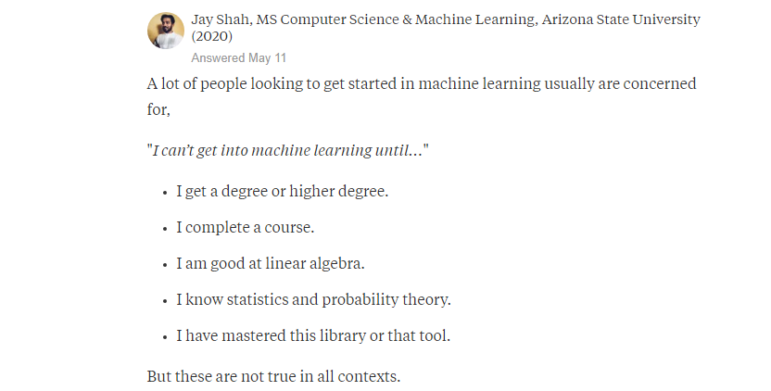
Common Myths Around AI
Which of them do you think is correct?

Slide 33

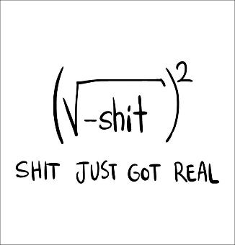
Starter Kit
Curiosity ( Ok with failure)
Self-Education

Slide 34
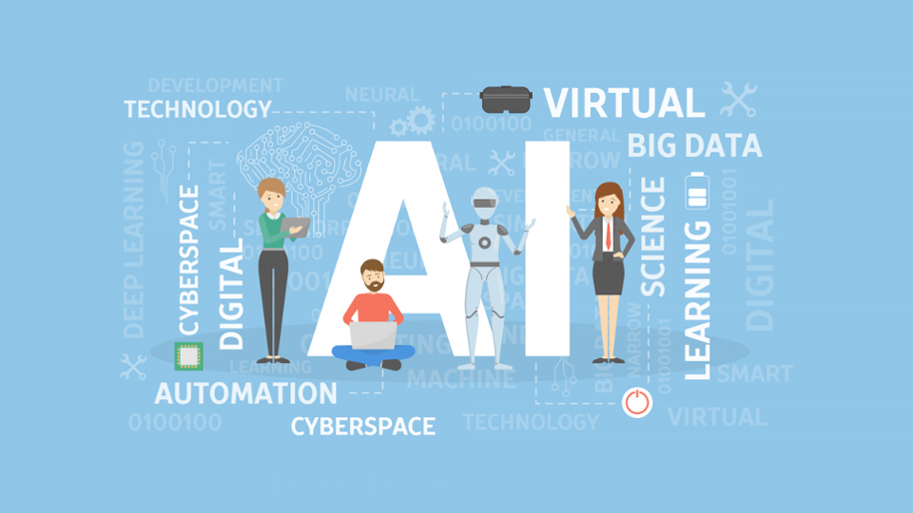
“AI will digitally disrupt all industries.
Don’t be left behind’’
- Dave Waters

Slide 35
